Slide 1

AI-AGENT TRAFFIC SMART CONTROLLER
TRAINER
KALKESEETHARAMA
GROUP MEMBERS
CH.SHANKARI 231FA04055 PROGRAM CO-ORDINATOR
N.TEJA 231FA04485 RAKESH REDDY
K.DEEPIKA 231FA04C69
SK.SADIYA 231FA04G17

Slide 2
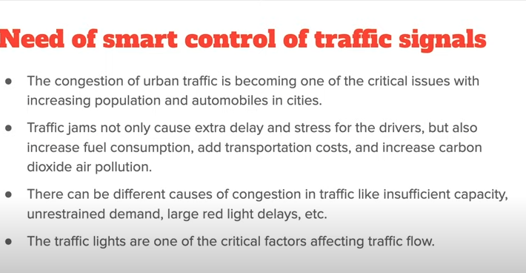

Slide 3
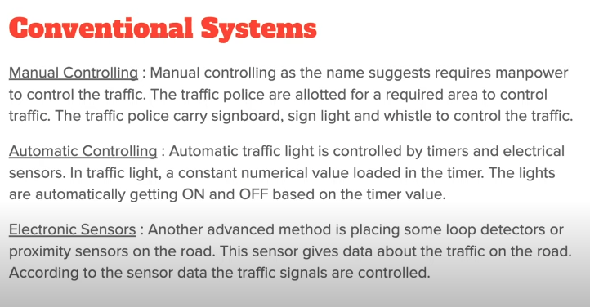

Slide 4
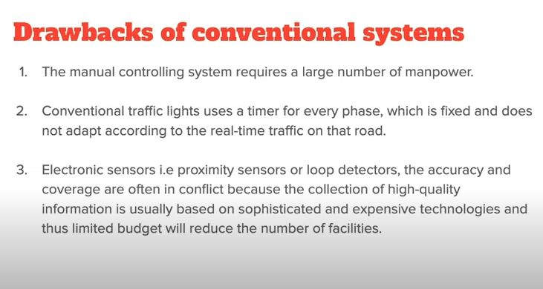


Slide 5
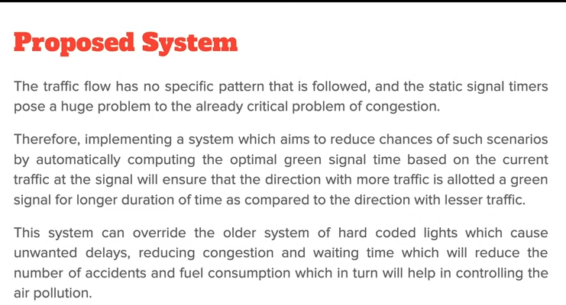

Slide 6
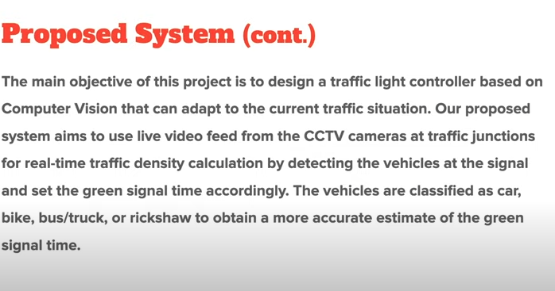

Slide 7
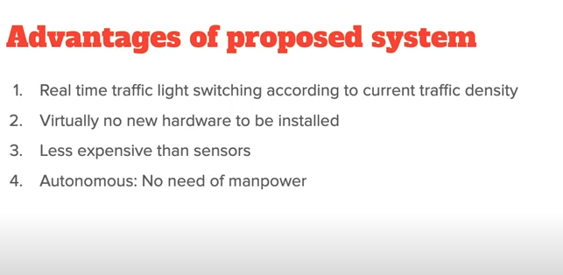

Slide 8
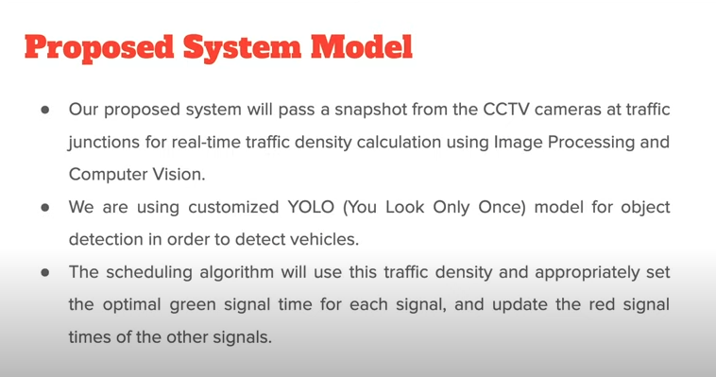

Slide 9
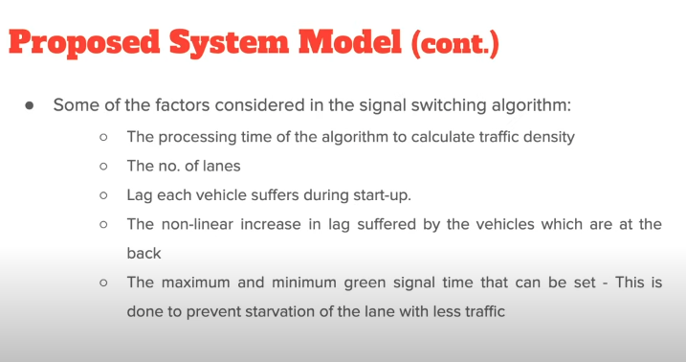

Slide 10
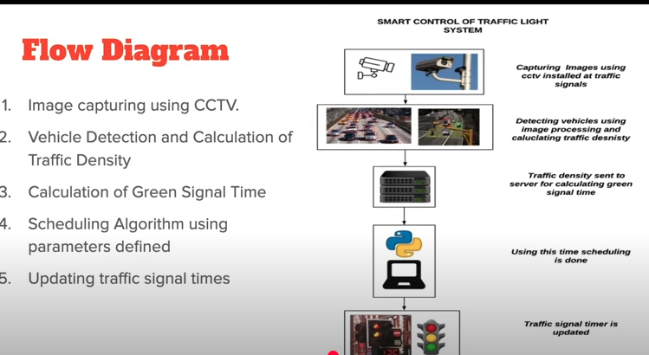

Slide 11
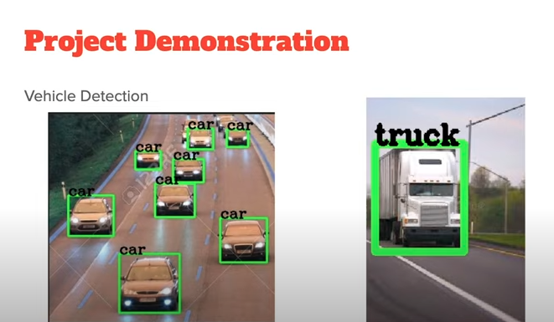

Slide 12
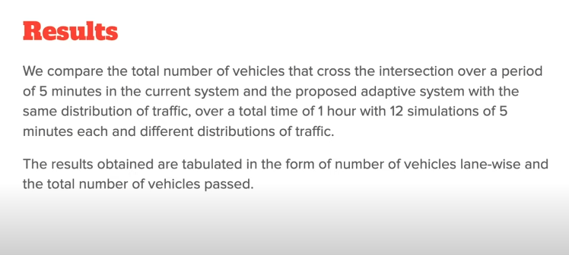

Slide 13
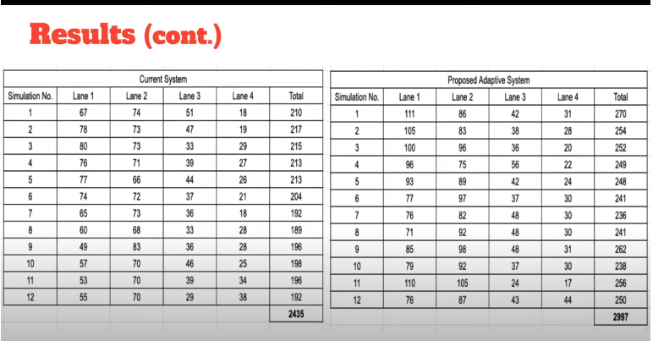

Slide 14
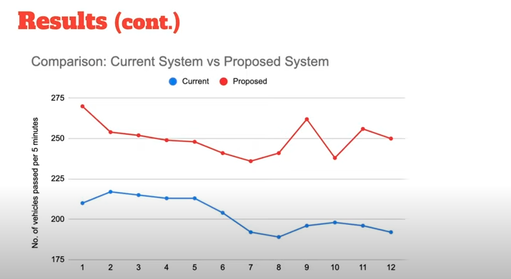

Slide 15
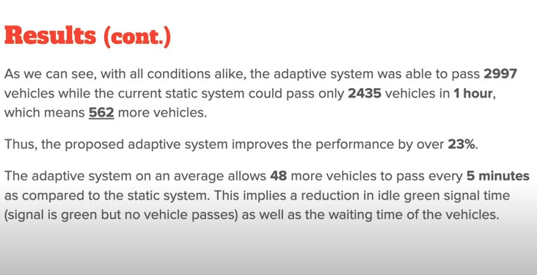

Slide 16
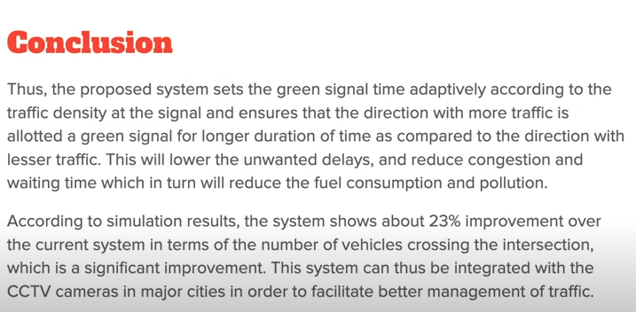

Slide 17
